Slide 1
File Operation
Sujoy Saha
Department of CSE
NIT Durgapur

Slide 2
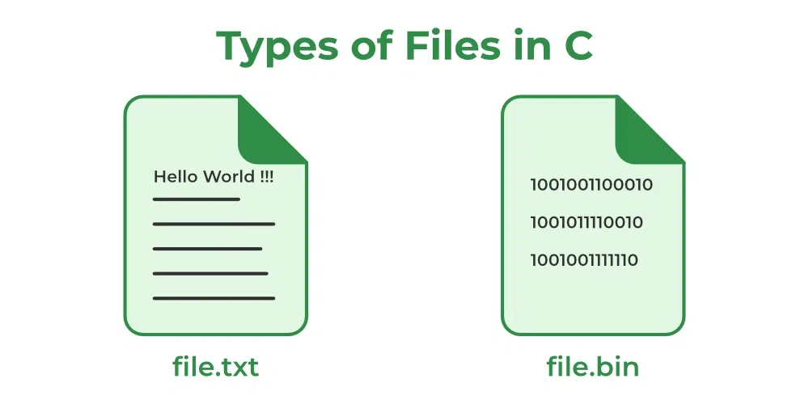
Types of Files in C
Text Files: A text file contains data in the form of ASCII characters and is generally used to store a stream of characters.
Binary Files: A binary file contains data in binary form (i.e. 0’s and 1’s) instead of ASCII characters. They contain data that is stored in a similar manner to how it is stored in the main memory.

Slide 3

Types of Files in C
011010
011010
ASCII
ASCII^{R}

Slide 4

When dealing with audio files (like .wav, .mp3, .flac, etc.) in C, the correct choice is almost always to use binary mode ("rb", "wb", "ab", etc.) rather than text/ASCII mode ("r", "w", "a").

Slide 5

Types of Files in C
011010
011010
CODEC
CODEC^{R}

Slide 6
Why Binary Mode is Better (and Safer) for Audio/Video Files
Audio files are binary by nature
  They don’t store human-readable text, but raw byte sequences representing samples, headers, metadata, etc.
the file is read and written exactly as it is, byte by byte.
  This ensures that the data is preserved without any modification, making it ideal for non-text files like images, videos, or executables.
Text mode may corrupt the file
  In text mode, the runtime library may automatically translate certain characters (e.g., '\n' into "\r\n" on Windows).
  That breaks the structure of audio files, since even one altered byte can make the file unreadable.
  There is no risk of accidental data corruption due to character encoding or newline conversions.

Slide 7
Why Binary Mode is Better (and Safer) for Audio/Video Files
Portability
  If you write in text mode, behavior may differ between platforms (Windows vs Linux vs macOS).
  Binary mode guarantees consistent, byte-for-byte I/O across systems.

Slide 8
TCP/IP Socket Programming in C
Sujoy Saha
Department of CSE
NIT Durgapur

Slide 9
TCP/IP Protocol Suite
Application Process
Application Process
OSI Layer 5-7
TCP
UDP
OSI Layer 4
ICMP
IP
ARP
RARP
OSI Layer 3
Hardware Interface
OSI Layer 1-2

Slide 10
Sending Data
data
Application Layer
16-bit TCP/UDP Source Port Number
16-bit TCP/UDP Destination Port Number
UDP/TCP Header
data
Transport Layer
Protocol = UDP/TCP
32-bit Source IP Address
32-bit Destination IP Address
IP Header
UDP/TCP Header
data
Network Layer
Frame Type = IP
Ethernet 48-bit Source Address
Ethernet 48-bit Destination Address
Data-Link Layer
Ethernet Header
IP Header
UDP/TCP Header
data
Ethernet Trailer
Ethernet Frame

Slide 11
Receiving Data
data
Application Layer
16-bit TCP/UDP Source Port Number
16-bit TCP/UDP Destination Port Number
UDP/TCP Header
data
Transport Layer
Protocol = UDP/TCP
32-bit Source IP Address
32-bit Destination IP Address
IP Header
UDP/TCP Header
data
Network Layer
Frame Type = IP
Ethernet 48-bit Source Address
Ethernet 48-bit Destination Address
Data-Link Layer
Ethernet Header
IP Header
UDP/TCP Header
data
Ethernet Trailer
Ethernet Frame

Slide 12


Socket
“A network socket is an endpoint of an inter-process communication across a computer network."

Slide 13
Connection
In TCP/IP protocol suite
  a connection defines the communication link between two processes
  An association defined by the 5-tuple completely specifies two processes that make up a connection
{protocol, local-addr,local-port, foreign-addr, foreign-port}
    The protocol (TCP or UDP)‏
    The local host’s IP address (32-bit)‏
    The local port number (16-bit)‏
    The foreign host’s IP address (32-bit)‏
    The foreign port number (16-bit)‏
Example
{tcp, 192.168.2.2, 1500, 192.168.2.10, 21}

Slide 14
Sockets
Sockets are application program interface (API) to the communication protocol.
Availability of an API depends both on the operating system and the programming language.

Slide 15
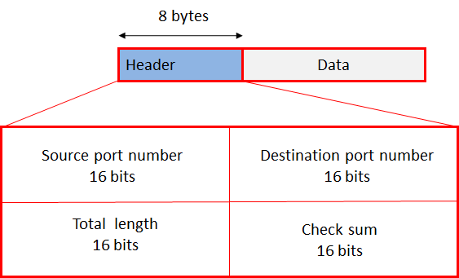
Socket Addresses
{tcp/UDP, 192.168.2.2, 1500, 192.168.2.10, 21}
For Internet family, following structures are defined in
<netinet/in.h>
struct in_addr {
u_long s_addr; /*32-bit netid/hostid*/
};
struct sockaddr_in {
short sin_family; /*AF_INET*/
u_short sin_port; /*16-bit port number*/
struct in_addr sin_addr; /*32-bit netid/hostid*/
char sin_zero[8]; /*unused*/
};
The header file <sys/types.h> provides data type definitions

Slide 16
Socket Addresses
{tcp/UDP, 192.168.2.2, 1500, 192.168.2.10, 21}
For Internet family, following structures are defined in
<netinet/in.h>
struct in_addr {
u_long s_addr; /*32-bit netid/hostid*/
};
struct sockaddr_in {
short sin_family; /*AF_INET*/
u_short sin_port; /*16-bit port number*/
struct in_addr sin_addr; /*32-bit netid/hostid*/
char sin_zero[8]; /*unused*/
};
The header file <sys/types.h> provides data type definitions
In the socket API, the family (sometimes called domain) tells the operating system what kind of addresses the socket will use.
AF_INET → IPv4 addresses (e.g., 192.168.1.1)
AF_INET6 → IPv6 addresses (e.g., 2001:db8::1)
AF_UNIX / AF_LOCAL → Local (Unix domain) sockets for communication on the same machine – Not use IP Address
  it uses a file path in the filesystem (e.g., /tmp/mysocket) to identify the communication endpoint.

Slide 17
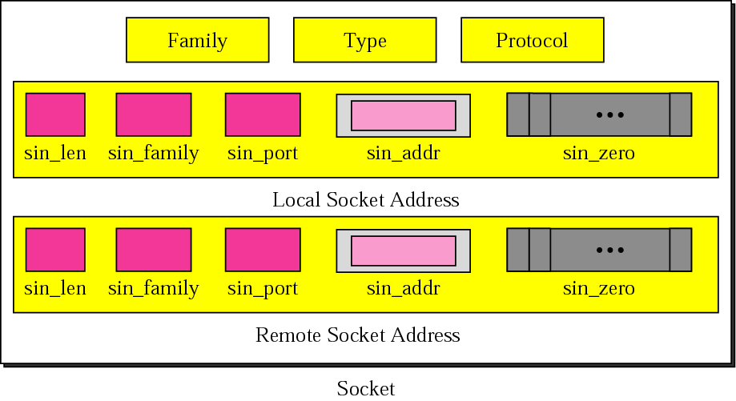
Figure 16-4
Socket structure
Communication domain in which the socket should be created. Some of address families are AF_INET (IP), AF_INET6 (IPv6), AF_UNIX (local channel, similar to pipes), AF_ISO (ISO protocols), and AF_NS (Xerox Network Systems protocols).
Notes:
The AF_UNIX (also known as AF_LOCAL) socket family is used to communicate between processes on the same machine efficiently.

Slide 18
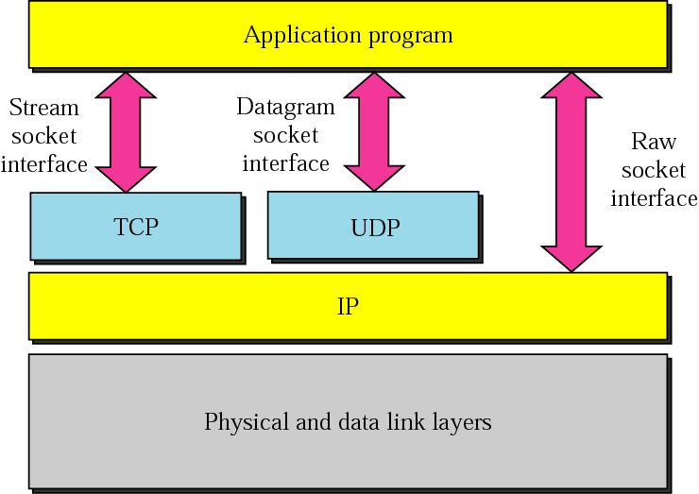
Figure 16-5
Socket types

Slide 19
BYTE ORDERING

Slide 20
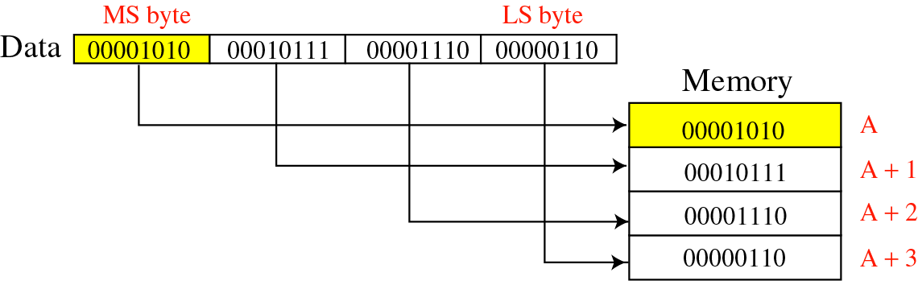
Figure 16-6
Big-endian byte order

Slide 21
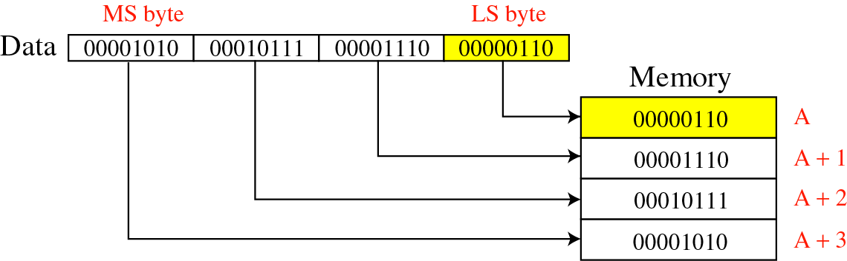
Figure 16-7
Little-endian byte order

Slide 22

The byte order for the TCP/IP
protocol suite is big endian.

Slide 23
Byte Ordering Functions
Hosts can store multi-byte values differently (host byte order)‏
  Little-endian byte order
  Big-endian byte order
Network protocols must specify a network byte order
  Internet protocols use big-endian byte ordering
Byte ordering routines
u_long htonl(u_long hostlong);
u_short htons(u_short hostshort);
u_long ntohl(u_long netlong);
u_short ntohs(u_short netshort);
u_long: A data type that can store non-negative integers. The size is usually 4 (32 bit machine) or 8 bytes (64 bit machine), depending on the system.
Often defined as a shorthand for unsigned long, usually in system headers or legacy code.
It's not part of the standard C library but may appear in codebases or system-specific headers.

Slide 24
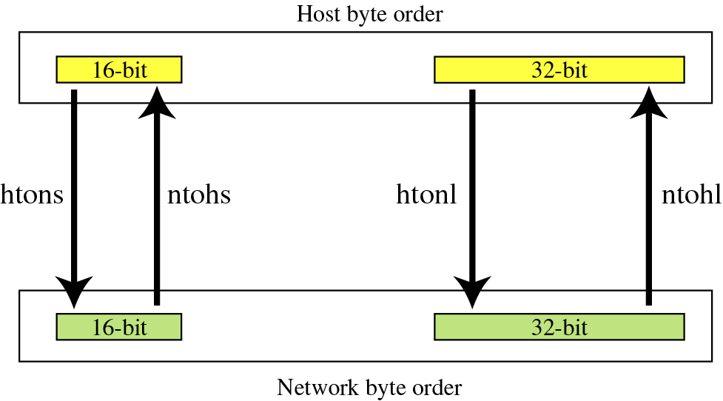
Figure 16-8
Bite-order transformation

Slide 25
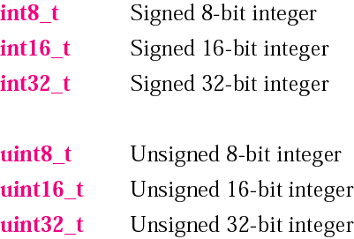
Figure 16-1
Data types
#include<stdint.h>
-128 to 127 [7 bit → number and 1 bit for sign]
Only positive numbers→0-255[utilizing all 8 bits]

Slide 26
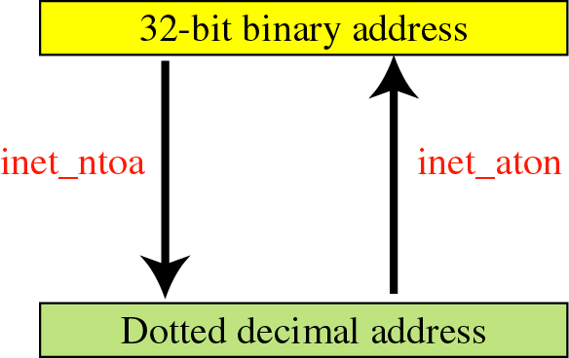
The inet_ntoa function in C is used to convert an IP address in a numerical format (stored as a struct in_addr) into a human-readable dotted-decimal string (e.g., 192.168.1.1).
Figure 16-10
Address transformation

Slide 27
Address Conversion Routines
unsigned long inet_addr(char *ptr);
int inet_aton(char *ptr, struct in_addr *addrptr);
Converts a character string in dotted-decimal notation to a 32-bit Internet address in network byte order
char *inet_ntoa(struct in_addr inaddr);
Converts a 32-bit Internet address in network byte order to a character string in dotted decimal notation

Slide 28
BYTE
MANIPULATION
FUNCTIONS

Slide 29
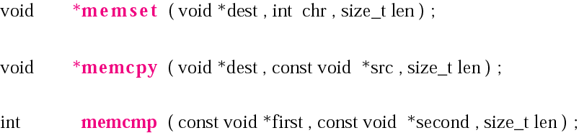
Declarations for byte-manipulation
functions
struct MSG
{
int m_txt[MAX_TEXT];
int m_seq;
int total_no_of_packets;
};
char buffer[1400];
memset(buffer,0,sizeof(buffer));
bzero(buffer, sizeof(buf));
memcpy(buffer, msg.m_txt, sizeof(msg.m_txt));

Slide 30
SOCKET SYSTEM
CALLS

Slide 31
socket System Call
int socket(int family, int type, int protocol);
The family is one of
AF_UNIX Unix internal protocols
AF_INET Internet Protocols
AF_NS Xerox NS Protocols
AF_IMPLINK IMP link Layer
AF_INET uses the TCP/IP protocol.
AF_UNIX creates filesystem objects and it only works between processes on the same host.
AF_NS is a set of protocols that were used by Xerox Systems for data communication. Its basic working mechanism is almost the same as in the TCP/IP protocol suit, but XNS contains only two network layers

Slide 32
AF_INET and AF_UNIX
AF_INET uses the TCP/IP protocol.
AF_UNIX creates filesystem objects and it only works between processes on the same host.
AF_UNIX is much faster than AF_INET.
Xerox Network Systems (XNS) is a set of protocols that were used by Xerox Systems for data communication. Xerox used XNS for file transfers, sharing network resources, packet transfers, sharing routing information and remote procedure calls. Its basic working mechanism is almost the same as in the TCP/IP protocol suit, but XNS contains only two network layers. This differs from the seven-layer Open Systems Interconnection (OSI) model, although the functionality is basically the same.

Slide 33
socket System Call
int socket(int family, int type, int protocol);
The family is one of
AF_UNIX Unix internal protocols
AF_INET Internet Protocols
AF_NS Xerox NS Protocols
AF_IMPLINK IMP link Layer
The socket type is one of the following
SOCK_STREAM Stream Socket
SOCK_DGRAM Datagram Socket
SOCK_RAW Raw Sockets
SOCK_SEQPACKET Sequenced Packet Socket
SOCK_RDM Reliably Delivered Message Socket
The protocol argument to the socket system call is typically set to 0
The socket system call returns an integer value called socket descriptor
This number is passed as a parameter to almost all of the other library calls.

Slide 34
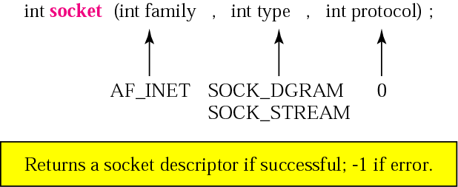
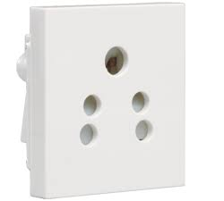
Figure 16-15
Declaration for socket function
The socket( ) system call returns a file descriptor.
In fact, a socket is similar to an opened file because it is possible to read and write data on it by means of the usual read( ) and write( ) system calls.
in the context of the client-server model, the socket system calls needed to create and connect a pair of sockets and transmit data.
type family
AF_INET
SOCK_STREAM
TCP or SCTP
Protocol
SOCK_DGRAM
UDP
IPPROTO_TCP
SOCK_SEQPACKET
SCTP
IPPROTO_UDP
SOCK_RAW
IPv4
IPPROTO_SCTP

Slide 35
Family Description
AF_UNIX UNIX internal (file system sockets)‏
AF_INET ARPA Internet protocols (UNIX network sockets)‏
AF_ISO ISO standard protocols
AF_NS Xerox Network Systems protocols
AF_IPX Novell IPX protocol
AF_APPLETALK Appletalk DDS

Slide 36

bind
PORT
bind system call:
bind() associates the socket with its local address
The bind() system call binds an address (IP & PORT)
IP
#include <sys/socket.h>
int bind( int sockfd, const struct sockaddr * myaddr, socklen_t addrlen );
Returns: 0 if OK, -1 on error
sockaddr is a generic structure, bind system call uses typepunning
e.g. bind()‏
myaddr.sin_family = AF_INET;
myaddr.sin_addr.s_addr = htonl( INADDR_ANY );
myaddr.sin_port = htons( 7 ); // 7 for echo service
if( bind( sockfd, (struct sockaddr *)&myaddr, sizeof(myaddr) ) < 0 ) { ... }

Slide 37
bind System Call
Uses of bind system call
  Servers register their well-known address with the system; both connection-oriented and connection-less servers need to do this
  A client can register a specific address for itself
The bind system call specifies the local-addr and local-port elements of the 5-tuple of an association
struct sockaddr_in {
short sin_family; /*AF_INET*/
u_short sin_port; /*16-bit port number*/
struct in_addr sin_addr; /*32-bit netid/hostid*/
char sin_zero[8]; /*unused*/
};
Struct sockaddr
{
unsigned short sa_family;
Char sa_data[14]
}
sin_port (2 Byte) + Sin_addr(4 Byte) + sin_Zero (8Byte) = 14 byte

Slide 38
Why is a bind system call required in socket programming?
Otherwise if a port is not binded to any socket descriptor, we can use the same port and IP combination again to connect to a different destination.
bind() assigns the address specified to by addr to the socket referred to by the file descriptor sockfd.
bind() associates the socket with its local address [that's why server side binds, so that clients can use that address to connect to server.]

Slide 39
sendto and recvfrom Functions
int sendto(int sockfd, char *buff, int length, int flags, struct sockaddr *to, socklen_t addrlen);
to argument is a socket address structure containing protocol address of where the data is to be sent
sockfd -- The socket descriptor.
buff --The pointer to the buffer containing the message to transmit.
length -- The length of the message in the buffer pointed to by the msg parameter.
Flags-- MSG_DONTROUTE -- Don't use a gateway to send out the packet, only send to hosts on directly connected networks. This is usually used only by diagnostic or routing programs ;
MSG_DONTWAIT - Enables nonblocking operation;
MSG_WAITALL requests blocking until the entire number of bytes requested can be read.
to --The address of the target.
addr_len --The size of the address pointed to by address.
Notes:
Flags -- The flags argument is the bitwise OR of zero or more of the following flags.
MSG_DONTROUTE -- Don't use a gateway to send out the packet, only send to hosts on directly connected networks. This is usually used only by diagnostic or routing programs.
MSG_DONTWAIT (since Linux 2.2)Enables nonblocking operation;
MSG_WAITALL requests blocking until the entire number of bytes requested can be read.

Slide 40
sendto and recvfrom Functions
A blocking system call is one that must wait until the action can be completed. read() would be a good example - if no input is ready, it'll sit there and wait until some is (provided you haven't set it to non-blocking, of course, in which case it wouldn't be a blocking system call)
If there is not enough available buffer space to hold the socket data to be transmitted, and the socket is in blocking mode, sendto() blocks the caller until additional buffer space becomes available.
Notes:
Flags -- The flags argument is the bitwise OR of zero or more of the following flags.
MSG_DONTROUTE -- Don't use a gateway to send out the packet, only send to hosts on directly connected networks. This is usually used only by diagnostic or routing programs.
MSG_DONTWAIT (since Linux 2.2)Enables nonblocking operation;
MSG_WAITALL requests blocking until the entire number of bytes requested can be read.

Slide 41
sendto and recvfrom Functions
int recvfrom(int sockfd, char *buff, int nbytes, int flags, struct sockaddr *from, socklen_t *addrlen);
Fills in the socket address structure pointed to by from with the protocol address of who sent the datagram
If no incoming data is available at the socket, the recvfrom function blocks and waits for data to arrive according to the blocking rules
Notes:
Flags -- The flags argument is the bitwise OR of zero or more of the following flags.
MSG_DONTROUTE -- Don't use a gateway to send out the packet, only send to hosts on directly connected networks. This is usually used only by diagnostic or routing programs.
MSG_DONTWAIT (since Linux 2.2)Enables nonblocking operation;
MSG_WAITALL requests blocking until the entire number of bytes requested can be read.

Slide 42
User datagram format :
8 bytes
Header Data
Data
Source port number
16 bits
Destination port number
16 bits
Total length
16 bits
Check sum
16 bits

Slide 43
UDP Client-Server
UDP Server
socket()‏
UDP Client
well-known port
bind()‏
socket()‏
recvfrom()‏
sendto()‏
data (request)‏
blocks until datagram received from a client
process request
sendto()‏
recvfrom()‏
data (reply)‏
close()‏

Slide 44
Header Files
#include <sys/socket.h> // Core BSD socket functions and data structures.
#include <netinet/in.h> // AF_INET and AF_INET6 address families and their corresponding protocol families PF_INET and PF_INET6.
#include <arpa/inet.h> // Functions for manipulating numeric IP addresses.
#include <netdb.h> // Name resolution

Slide 45
Example (UDP_CLIENT)‏
struct MSG
{
int m_txt[MAX_TEXT];
int m_seq;
int total_no_of_packets;
};
struct MSG msg;
struct sockaddr_in sa;
sock1 = socket(AF_INET,SOCK_DGRAM,0);
bytes_sent = sendto(sock1, (void*)&msg, sizeof(struct MSG),0,(struct sockaddr*) &sa, sizeof(struct sockaddr_in) );

Slide 46
Example (UDP_SERVER)‏
struct MSG
{
int m_txt[MAX_TEXT];
int m_seq;
int total_no_of_packets;
};
struct MSG msg;
int s_length;
struct sockaddr_in sa,cli;
sock1 = socket(AF_INET,SOCK_DGRAM,0);

Slide 47
Example UDP_SERVER
sa.sin_family = AF_INET;
sa.sin_port = htons(PORT);
sa.sin_addr.s_addr = htonl(INADDR_ANY);
s_length=sizeof(sa);
bind(sock1,(struct sockaddr *)&sa, s_length);
rec=recvfrom(sock1,(void*)&msg,sizeof(struct MSG),0,(struct sockaddr *) &cli,sizeof(cli) );

Slide 48
TCP Protocol

Slide 49
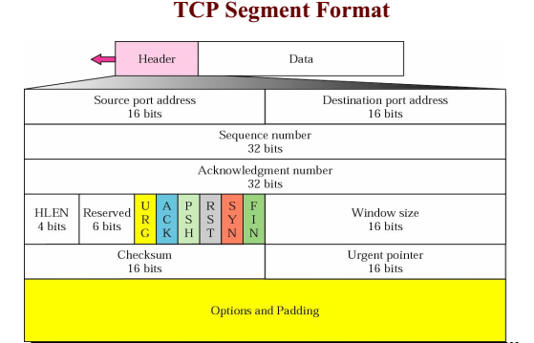

Slide 50
THREE-WAY HANDSHAKING
Process
Process
CLOSED
CLOSED
Active Open
Passive Open
SYN-SENT
SYN
LISTEN
SYN+ACK
SYN-RECVD
Established
ACK
Established
Passive Open:The application on the server is passive.
The application is listening, awaiting a connection
The application on the client makes a connection request to the server where the application is passive open.
The application on the client is said to be "active open".

Slide 51
TCP Client-Server
TCP Server
socket()‏
well-known port
bind()‏
listen()‏
TCP Client
socket()‏
accept()‏
connect()‏
blocks until connection from a client
connection establishment
send()‏
data (request)‏
recv()‏
process request
send()‏
recv()‏
data (reply)‏

Slide 52
connect System Call
int connect(int sockfd, struct sockaddr *servaddr, int addrlen);
For connection oriented protocols the connect system call results in the actual establishment of a connection between the local and foreign system
sockfd is a socket descriptor that was returned by the socket system call
servaddr is a pointer to an address structure containing the address of the server
addrlen is the length of the address structure

Slide 53
connect()‏
#include <sys/socket.h>
int connect( int sockfd, const struct sockaddr * servaddr, socklen_t addrlen );
Returns: 0 if OK, -1 on error
e.g. connect()‏
  struct sockaddr_in servaddr;
...
servaddr.sin_family = AF_INET;
servaddr.sin_addr.s_addr = htonl( “220.95.133.100” );
servaddr.sin_port = htons( 7 ); // 7 for echo service
if( connect( sockfd, (struct sockaddr *)&servaddr, sizeof(servaddr) ) < 0 )‏
{ ... }
...

Slide 54
listen System Call
int listen(int sockfd, int backlog);
This system call is used by a connection-oriented server to indicate that it is willing to receive connection
Called after both the socket and bind system calls, and immediately before the accept system call
The backlog argument specifies how many connection requests can be queued by the system while it waits for the server to execute the accept system call
That number is only the size of the connection queue, where new connections wait for somebody to accept them. As soon as your application calls accept(), a waiting connection is removed from that queue. So, you can definitely handle more than 128 simultaneous connections because they usually only spend a short time in the queue

Slide 55
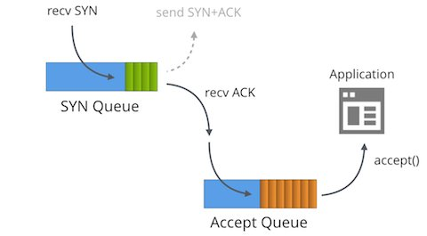
Listen()
Connect()
Queue
As soon as your application calls accept(), a waiting connection is removed from that queue.
Accept()
Connect()
Connect()
Connect()
Read/write operation
Buffer

Slide 56
accept System Call
int accept(int sockfd, struct sockaddr *peer, int *addrlen);
Takes first connection request on the queue and creates another socket with the same property as sockfd
Blocks the caller if no connection request is pending
peer argument return the address of the connected peer client
addrlen returns the length of the client address structure

Slide 57
listen() and accept()‏
#include <sys/socket.h>
int listen( int sockfd, int backlog );
Returns: 0 if OK, -1 on error
int accept( int sockfd, struct sockaddr * cliaddr, socklen_t * addrlen )‏
Returns: non-negative descriptor if OK, -1 on error
e.g. listen()‏
  #define LISTENQ 5
...
if( listen( mysock, LISTENQ ) < 0 ) { ... }
while( 1 ){
clilen = sizeof( cliaddr );
if( ( clisockfd = accept( mysock, (struct sockaddr *)&cliaddr, &clilen ) ) < 0 ) { ... }
...
}

Slide 58
recv() and send()‏
#include <sys/types.h>
#include <sys/socket.h>
int recv( int sockfd, void * msg, size_t len, int flags );
int send( int sockfd, const void * msg, size_t len, int flags );
Both return: number of bytes read or written if OK, -1 on error
msg: message you want to send
len: length of the message
flags := 0
returned: the number of bytes actually sent or received
e.g. send() and recv()‏
  if( ( n = send( sockfd, buff, len, 0 ) ) != len ){ ... }
...
if( ( n = recv( sockfd, buff, BUFMAX, 0 ) ) < 0 ) { ... }

Slide 59
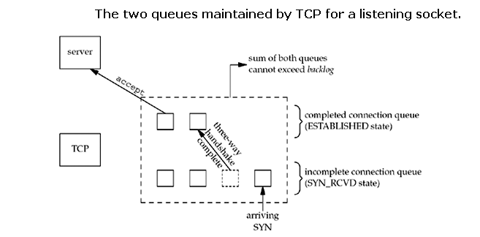

Slide 60
THREE-WAY HANDSHAKING
CLIENT
SERVER
Process
Process
CLOSED
CLOSED
Active Open
Passive Open
SYN-SENT
SYN
LISTEN
SYN+ACK
SYN-RECVD
Established
ACK
Established

Slide 61
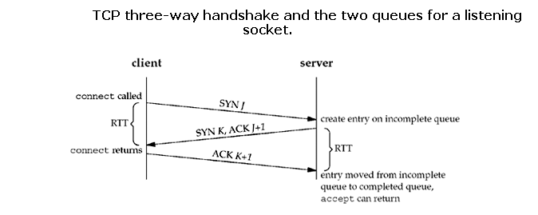

Slide 62
TCP Client-Server
TCP Server
socket()‏
well-known port
bind()‏
listen()‏
TCP Client
socket()‏
accept()‏
connect()‏
blocks until connection from a client
connection establishment
send()‏
data (request)‏
recv()‏
process request
send()‏
recv()‏
data (reply)‏

Slide 63
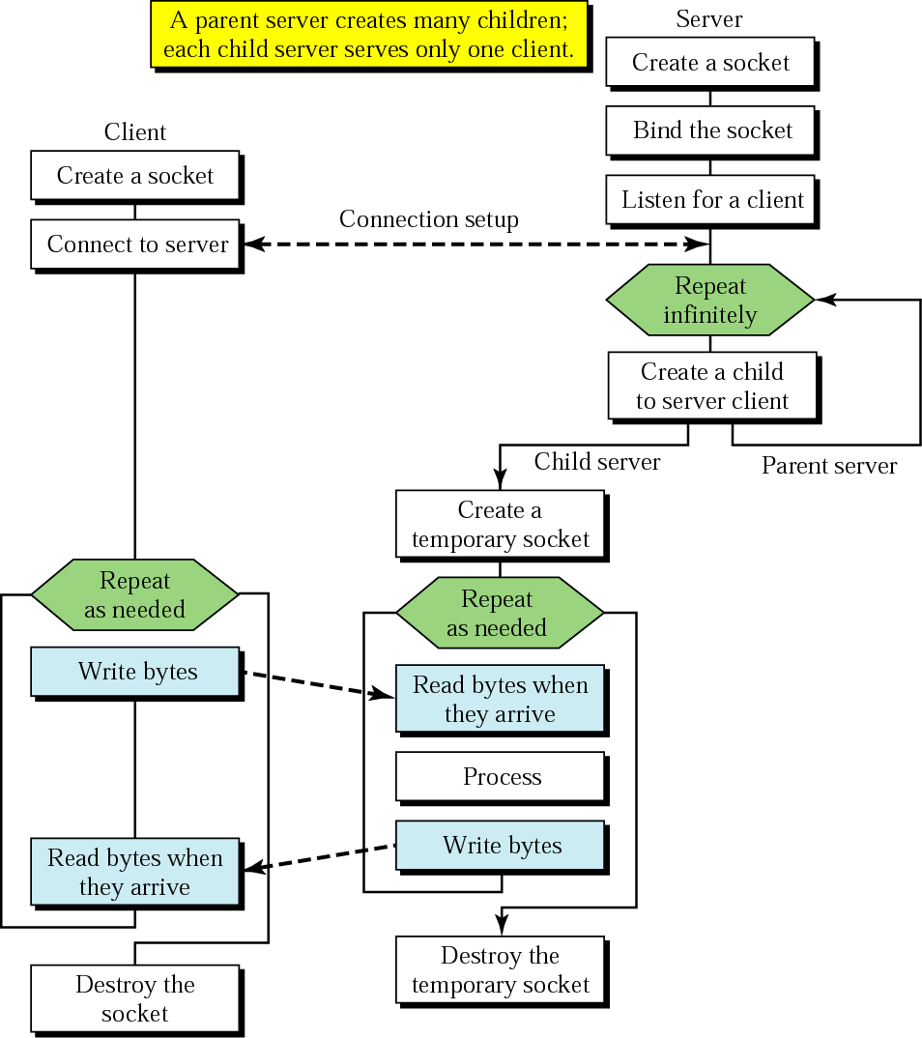
Client+server: connection-oriented
BIND
SOCKET
LISTEN
CONNECT
TCP three-way handshake
ACCEPT
SEND
RECEIVE
SEND
RECEIVE
CLOSE
Concurrent server

Slide 64
TCP SERVER
struct sockaddr_in server_addr,client_addr;
int sin_size;
if ((sock = socket(AF_INET, SOCK_STREAM, 0)) == -1)
perror("Socket");
exit(1);
}
server_addr.sin_family = AF_INET;
server_addr.sin_port = htons(5000);
server_addr.sin_addr.s_addr = INADDR_ANY;
bzero(&(server_addr.sin_zero),8);
if (bind(sock, (struct sockaddr *)&server_addr, sizeof(struct sockaddr)) ==-1)
{
perror("Unable to bind");
exit(1);
}

Slide 65
TCP SERVER
if (listen(sock, 5) == -1)
{
perror("Listen");
exit(1);
}
sin_size = sizeof(struct sockaddr_in);
connected = accept(sock, (struct sockaddr *) &client_addr, &sin_size);
char send_data[1024],recv_data[1024];
gets(send_data);
send(connected, send_data,strlen(send_data), 0);

Slide 66
TCP CLIENT
struct sockaddr_in server_addr;
if ((sock = socket(AF_INET, SOCK_STREAM, 0)) == -1)
{
perror("Socket");
exit(1);
}
server_addr.sin_family = AF_INET;
server_addr.sin_port = htons(5000);
server_addr.sin_addr = inet_addr(“server IP Address”); //inet_addr(“192.168.148.12”)‏
bzero(&(server_addr.sin_zero),8);
if (connect(sock, (struct sockaddr *)&server_addr, sizeof(struct sockaddr)) == -1)
{
perror("Connect");
exit(1);
}

Slide 67
TCP CLIENT
char recv_data[1024];
bytes_recieved=recv(sock,recv_data,1024,0);

Slide 68
References
Unix Network Programming, Volume 1, Second Edition
  W Richard Stevens
  Pearson Education

